Slide 1
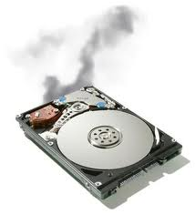
Predicting Hard Drive Failures using Machine Learning
Asanga Ramanayaka
Gamage Upeksha Maduwanthi Perera
Shadi Moradi
Venkata SaiRam Sampath Yelchuri
Notes:
Before I proceed

Slide 2
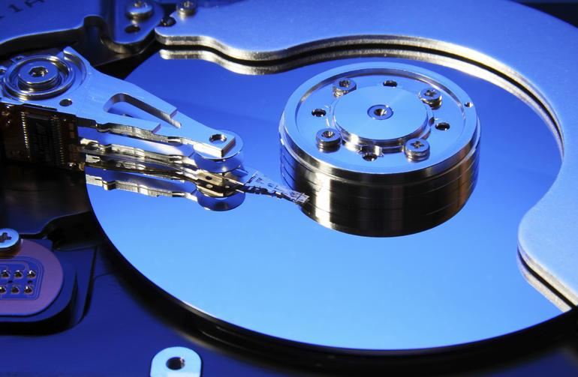
Hard Drive Failures
Most frequently replaced device (Vishwanath et al.)
Self-Monitoring Analysis and Reporting Technology (S.M.A.R.T.)
Attributes - read error rate, seek error rate, spin up time, temperature, power on hours, reallocated sectors count
Notes:
People produce massive amount of data
Commonly used
Most commonly replaced storage device (Vishvanath et al.)
Failures can be extremely costly,
Irreplaceable data loss or live server crash ->million of $$$
Many hardware manufacturers introduced SMART

Slide 3
Dataset
Backblaze dataset
Time period 2013-2019
Daily recorded .csv file for each day
Around 30,000 records in each file.
More than 150 million of total number of records
Focus
Year 2017 Quarter 1 -> Number of failed drives 385 (Total: 6.6 million)
Hitachi, Seagate, Western Digital and Toshiba
Notes:
Reasons for Choosing -> Freely available, .csv file
5 SMART attributes will be focused

Slide 4
Dataset (2017 Q1)
Manufacturer | No. of Records | Working hdd | Failed hdd | Failure percentage
Toshiba | 33,793 | 33,787 | 6 | 0.0178%
Western Digital | 183,671 | 183,663 | 8 | 0.0044%
HGST (Hitachi) | 2,316,371 | 2,316,313 | 58 | 0.0025%
Seagate | 4,098,269 | 4,097,956 | 313 | 0.0076%
Total | 6,632,104 |  | 385 | 0.0058%

Slide 5
Methodology
Splitting into datasets
Cleaning datasets
Test the model
Train the model
Resampling (SMOTE/ADASYN)
Feature Selection
Train test split
Notes:
4 main steps to process data
Several other intermediate steps

Slide 6
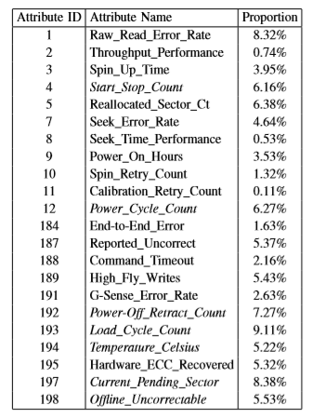
Literature
Aussel, Nicolas, et al. 2018
Backblaze dataset (Year 2014)
Consider only the nine raw SMART parameters
5, 12, 187, 188, 189, 190, 198, 199 and 200
Sampling technique: SMOTE
Logistic Regression / SVM/ RF
Notes:
Literature suggests that they have used SMART parameters number 5, 12, 187, 188, 189, 190, 198, 199 and 200 to do their comparisons.
But not all of these are there in the datasets.

Slide 7
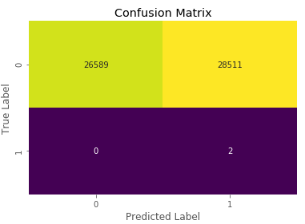
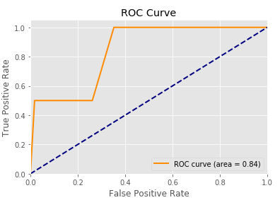
Results for Western Digital Hard-Drives (Literature)
Confusion Matrix Western Digital
precision recall F1-score
0 1.00 0.48 0.65
1 0.00 1.00 0.00
Random Forest Classifier accuracy score is 48.25 %
Area Under the ROC = 0.84

Slide 8
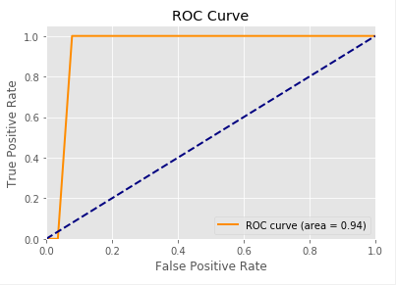
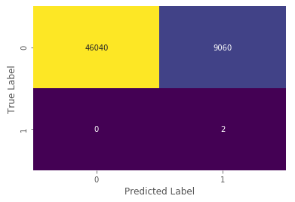
Results for Western Digital Hard-Drives (RFE)
Confusion Matrix Western Digital
precision recall F1-score
0 1.00 0.84 0.91
1 0.00 1.00 0.00
Random Forest Classifier accuracy score is 83.55 %
Area Under the ROC = 0.94

Slide 9
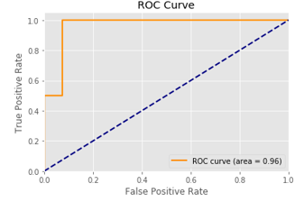
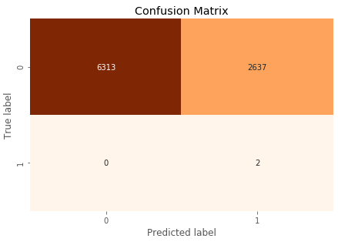
Results for Toshiba Hard-Drives (Literature)
Confusion Matrix for Toshiba
precision recall F1-score
0 1.00 0.71 0.83
1 0.00 1.00 0.00
Logistic Regression Classifier accuracy score is 70.54%
Area Under the ROC = 0.96

Slide 10
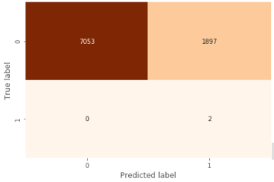
Results for Toshiba Hard-Drives (RFE)
Confusion Matrix for Toshiba
precision recall F1-score
0 1.00 0.79 0.88
1 0.00 1.00 0.00
Logistic Regression Classifier accuracy score is 79 %
Area Under the ROC = 0.96

Slide 11
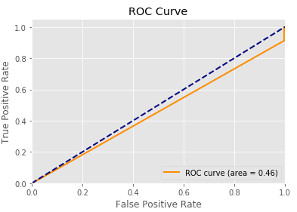
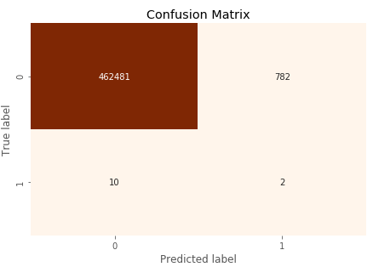
Results for Hitachi Hard-Drives (Literature)
Confusion Matrix Hitachi
Precision Recall F1-score
0 1.00 1.00 1.00
1 0.00 0.17 0.01
Decision Tree Classifier classifier_accuracy = 99.82%
Area Under the ROC = 0.46 <<<

Slide 12
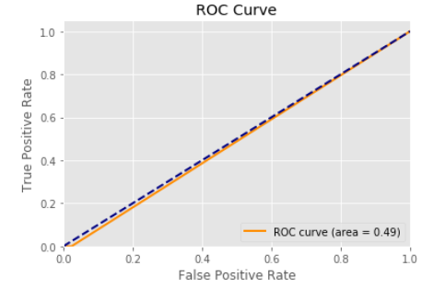
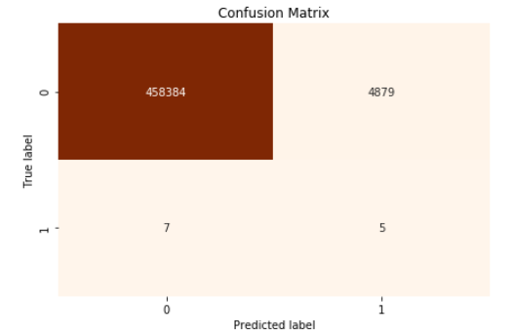
Results for Hitachi Hard-Drives (RFE)
Confusion Matrix Hitachi
Precision Recall F1-score
0 1 0.99 0.99
1 0.00 0.42 0.00
Decision Tree Classifier classifier_accuracy = 98%
Area Under the ROC = 0.49 <<<

Slide 13

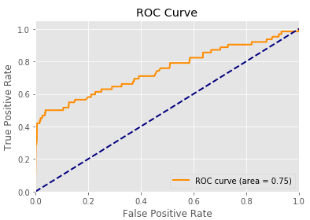
Results for Seagate Hard-Drives (Literature)
Confusion Matrix for Seagate
precision recall F1-score
0 1.00 1.00 1.00
1 0.01 0.18 0.02
Random Forest Classifier accuracy score is 99.90 %
Area Under the ROC = 0.75

Slide 14
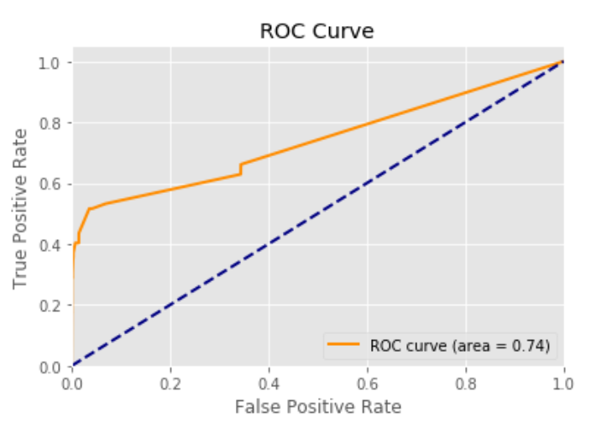
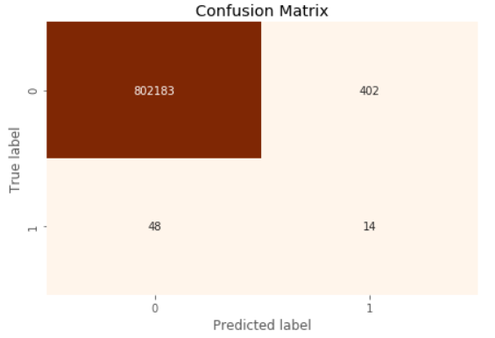
Results for Seagate Hard-Drives (RFE)
Confusion Matrix for Seagate
precision recall F1-score
0 1.00 1.00 1.00
1 0.03 1.23 0.06
Random Forest Classifier accuracy score is 99.94 %
Area Under the ROC = 0.74

Slide 15
Conclusion
For all the datasets, RFE based feature selection produced high accuracy than literature-based selection.
Seagate hard drive dataset, both methods produced similar results.
By Splitting the dataset based on manufacturer produced better results.
Machine Learning – issue of imbalanced data

Slide 16
Future Works
Using Artificial Neural Networks using TensorFlow
Use GPUs to improve efficiency
Analyze the whole dataset (2013-2019)
Try other over sampling techniques

Slide 17
Questions ? & Comments

